Slide 1


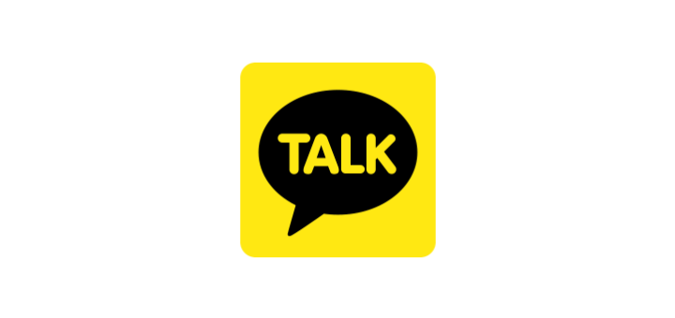
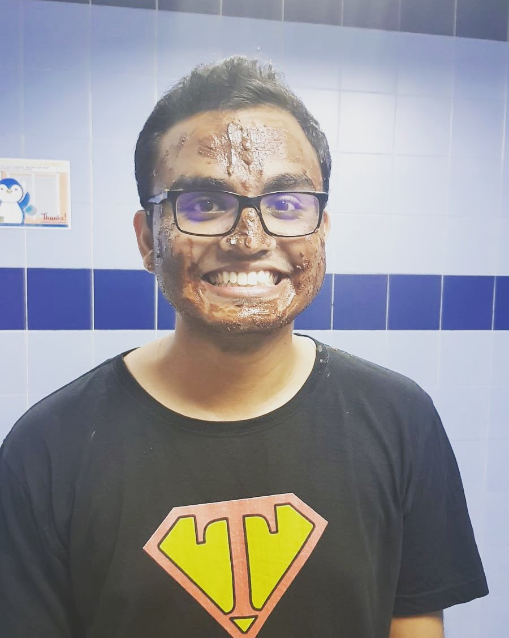




Mobile Mess
enger Services
Anirudh Srinivas Madhavan
Anusha Anandhan
Divya Kamal Maddi
Gao Yuxi
Swaminathan Venkatraman

Slide 2
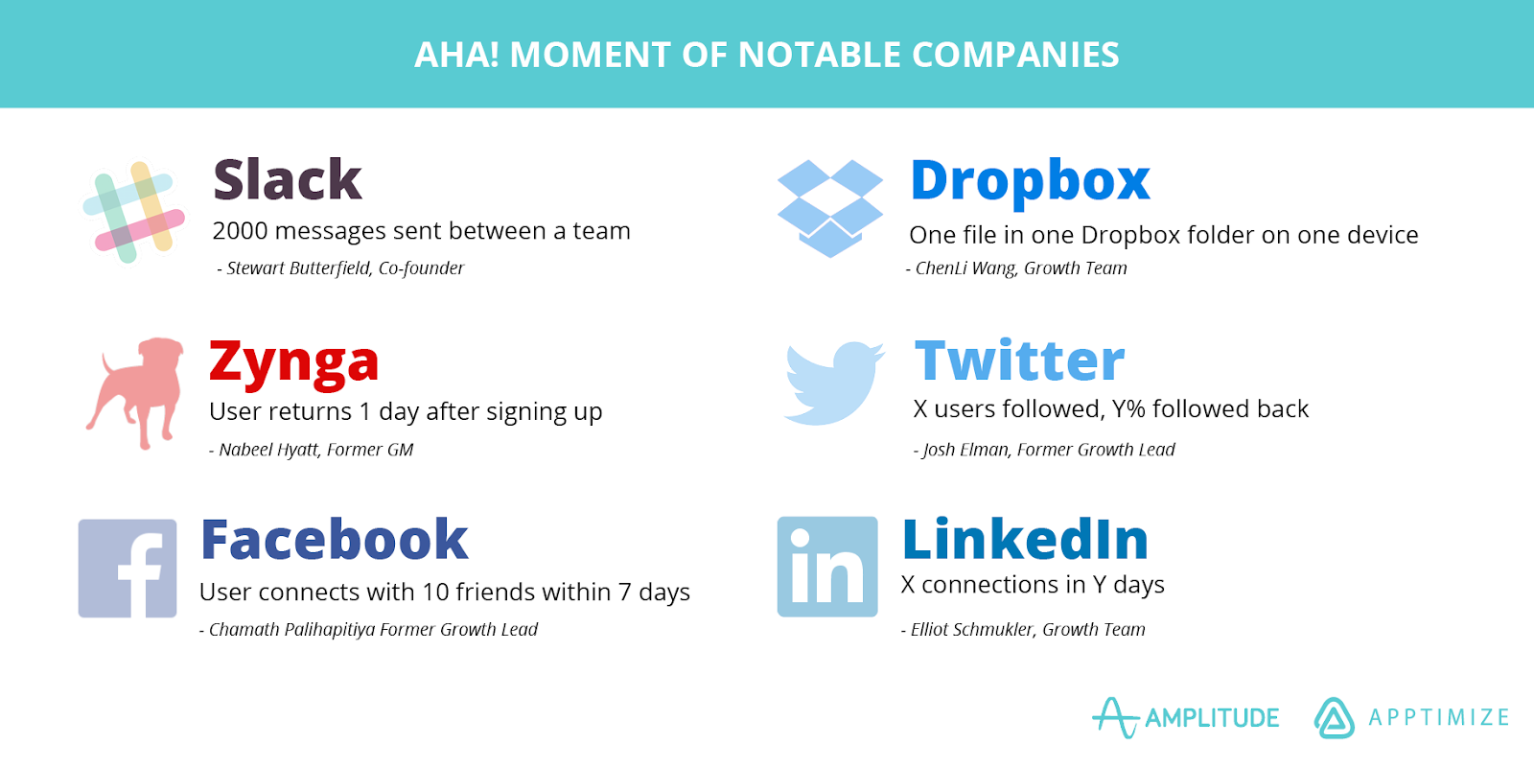
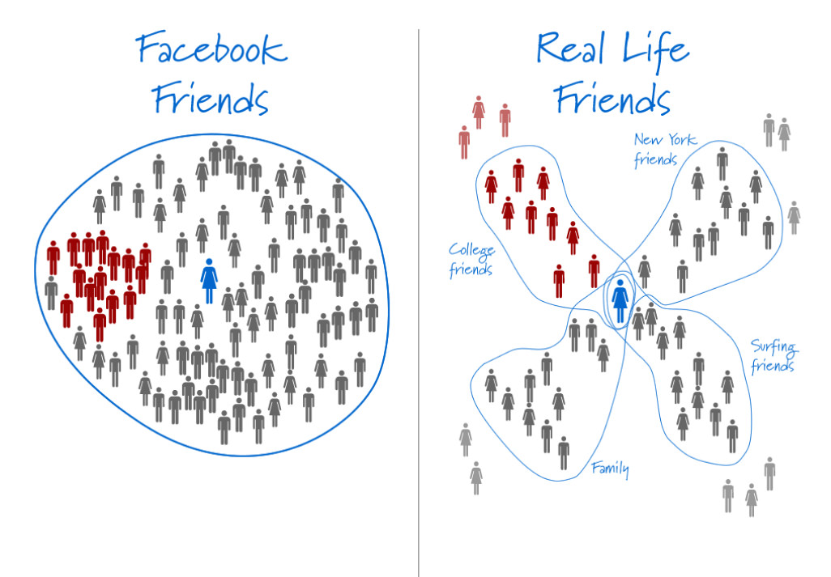
Let’s (s)talk Facebook!
Notes:
Origin of the term ‘Facebook circle’ - overlapping social circles
Interact with all my circles in one platform
Network effects - Quality over quantity
Local Network Effects
Critical Mass - Connections from underlying social graphs
10 friends in 7 days strategy
Virtual connections

Slide 3
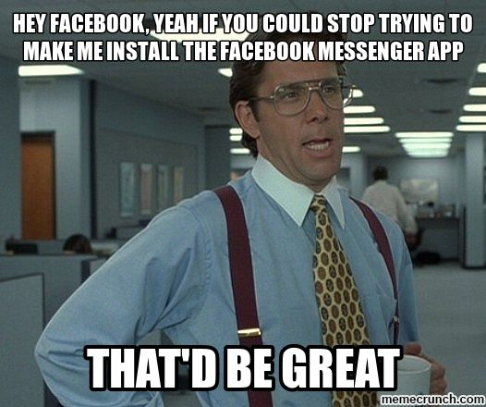
Wait, how does that relate to Messenger?
Standalone mobile application
Targets user’s FB circle
No need for contact number and FB account
App for first personal interaction
No need to create a new social graph)
Multiple accounts in one app - one phone: multiple users
Notes:
Standalone app - audacious strategy
FB circle - beyond contacts, wider circle
Pre-existing user base
Linked with FB - more contacts on FB, better
No need to create a new soial graph
No contact number required - wider circle
No FB account

Slide 4
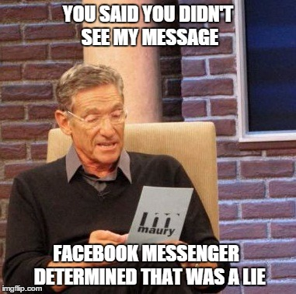
Meh, I have WhatsApp already.
Read Receipts
Video Calls
Location Sharing
Businesses
Payments
Messenger Bots
Notes:
Different from existing apps?
Features
Business - way to communicate with consumers
Payments platform - directly on Messenger
Share content with third party tools
Messenger bots - place orders easily, trying to become the e-Commerce platform of the future

Slide 5
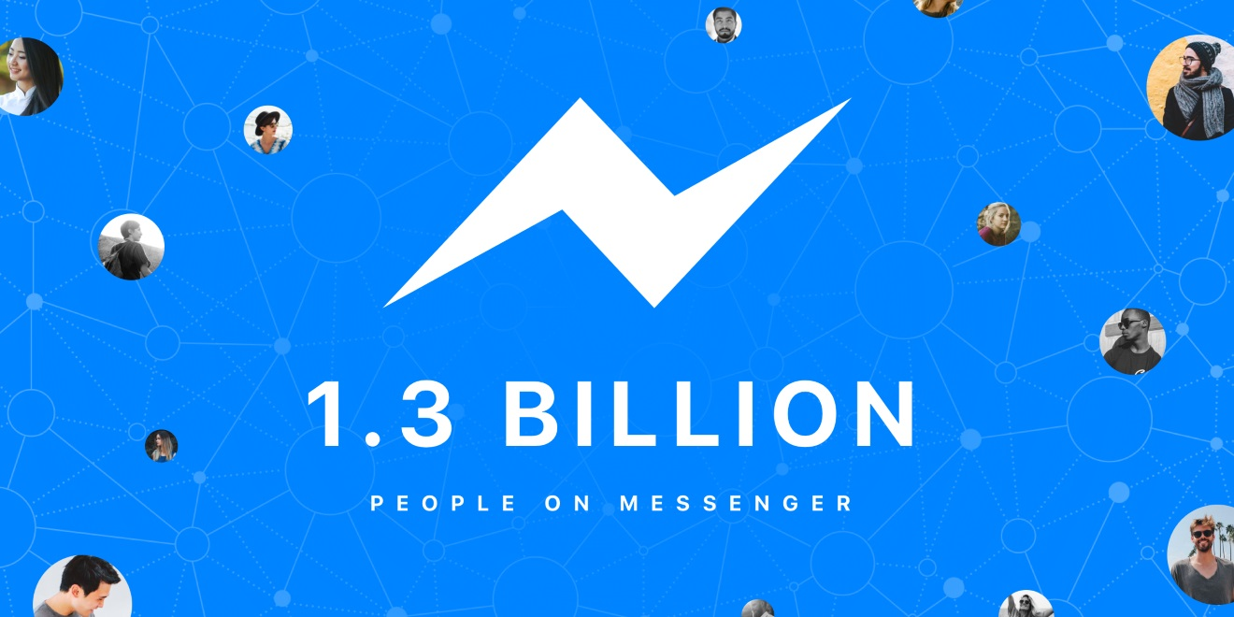

Slide 6
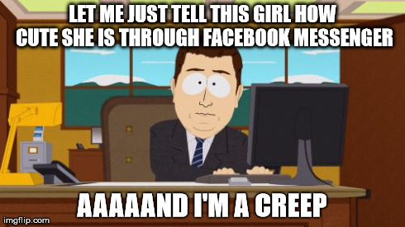
But is everything rosy and cozy?
Everyone you know is on Facebook/Messenger!
Anyone can find you and text you
It’s a pain to filter and configure your privacy settings
Quality of Messenger is decided by the quality of users on it

Slide 7
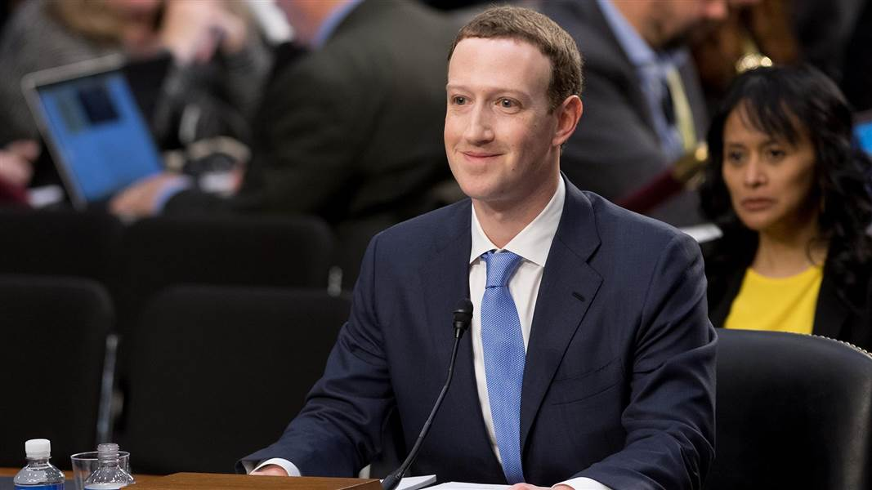
Sen. Orrin Hatch - “So, how do you sustain a business model in which users don’t pay for your service?”
Mark - “Senator, we run ads”
Notes:
Thanks Anirudh! I will discuss about Facebook messenger’s revenue driven by the two-sided market and how we think Facebook can increase its revenue.
So, how does facebook make money? As we all know, they run ads

Slide 8
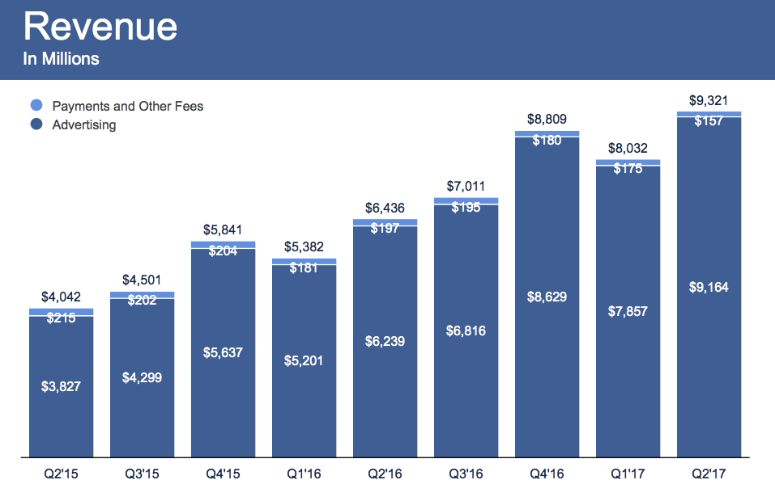
Notes:
From this graph its obvious that more than 90% of its revenue is driven by advertisements, and a very small percentage by other services

Slide 9
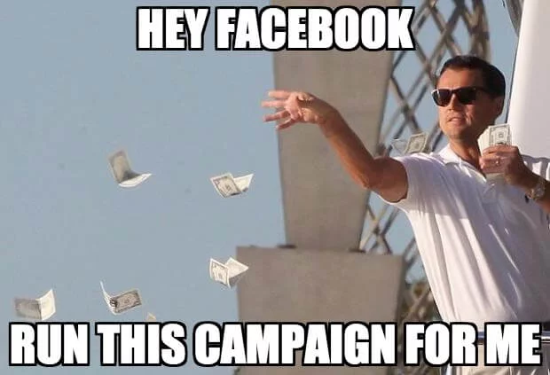
How $ comes from two sided market?
Content sharing apps - giphy
Customer service platform
Integrate messenger with FB pages
Messenger bots
Chat feed ads
Payments platform?
And a lot of other ways,
if you know what we mean ;)
Notes:
Now, let’s take a look at how messenger contributes to the revenue leveraging the two sided market:
In 2015, Facebook launched the Messenger platform, along with payments
This Platform allowed developers to market content sharing apps like giphy.
Businesses could integrate messenger with their ads/pages to communicate directly with their consumers.
In 2016 it went on to introduce messenger bots that could automate the conversation
Also businesses can run a campaign on facebook with any budget
Recently facebook has started allowing businesses to sandwich their ads between chats on messenger
They also launched a payments platform that allowed friends to transfer money to each other - but this generated very little revenue and now it just exists as a utility to provide frictionless user experience

Slide 10
63% of people are messaging more than they did two years ago
Vestibulum congue
Drive Awareness
Messenger for Business
80% of adults and 91% of teens use messaging apps every day
53% of people are more likely to shop with a business they can message
Enable Transactions
Acquire Customers
Vestibulum congue
Vestibulum congue
Customer Care
56% of people would rather message than call customer service
Notes:
So how does messenger help businesses?
People are messaging more than they did two years ago
Also the daily use of messaging apps among adults and teens has gone up to 80% and more
As more people prefer texting to calling, this allows businesses to use messenger to
Drive awareness
Acquire new customers
Provide customer service
Enable transactions

Slide 11
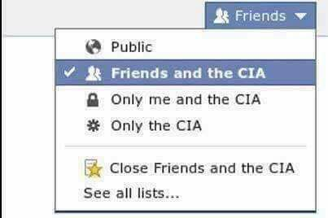
How can they make more $?
Becoming the yellow pages of businesses
Focus on generating revenue from users
Charge users for better experience like ad-free feeds, privacy
Pay for authenticated, private and trusted conversations with medical and other sensitive services.
Payments platform - once the no. of transactions hits a target
Notes:
Facebook has a very strong plan to increase their revenue, here are a few tiny ideas that we think would help
First, it can become the go to place for users to find any service/product
Second, it should focus on generating revenue from the consumers - provide privacy and ad-restriction privileges to premium users
Charge for authenticating businesses that provide sensitive services like health related counselling/consulting
Finally, when they have established themselves as an e-commerce platform - start charging on transactions.
We have come to the end of our discussion on messenger and now lets katalk

Slide 12
IN KOREA,
TEXT ME <=> KATALK ME
Notes:
Katalk -> pioneer of mobile message application within Asia, dominant in Korea

Slide 13

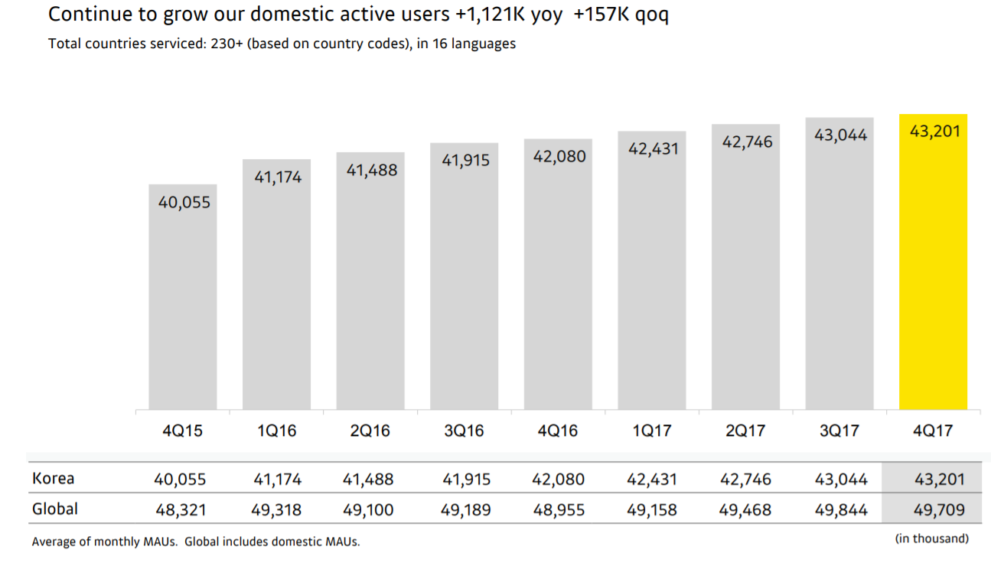
Why haven’t I heard of it?
Launched
Key Market
Total Users
2010
South Korea
97% of Korea
Notes:
Active users
KakaoTalk - 2010, 97% in Korea, 43 mil korea - 49 worldwide

Slide 14

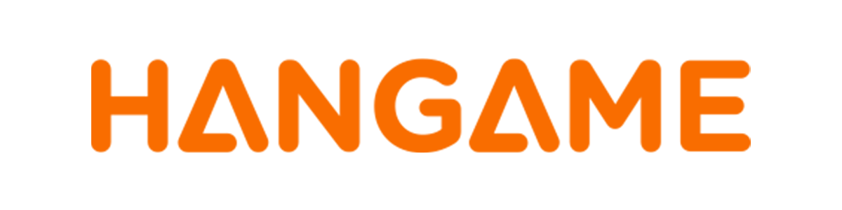


So, let’s KaTalk!
KIM BEOM-SOO
Notes:
Network effect factors stimulate to the app’s massive success
KBS, not only… but also one of the essential accelerators for the rapid development during the initial stage
Icon, HanGame
realize …. Via the success in online chat room feature
Started to target at mobile application development in 2007
His fame and reputation

Slide 15
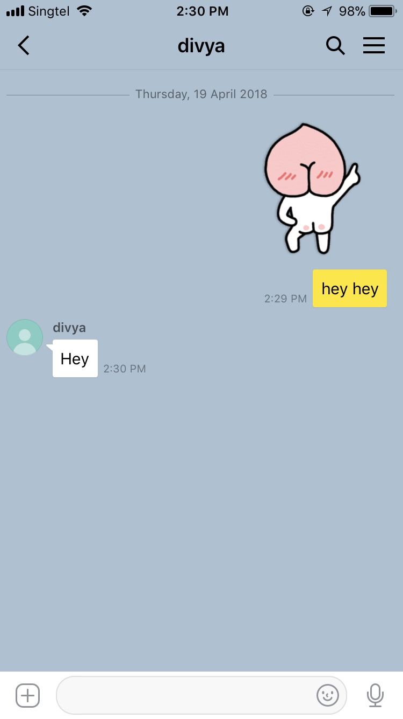
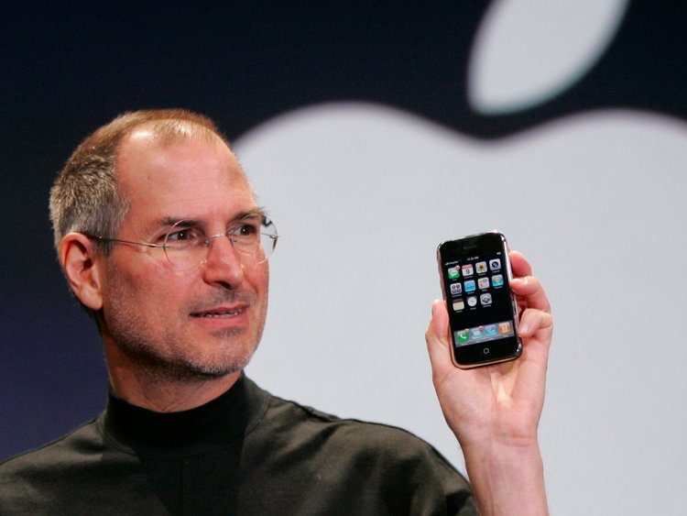
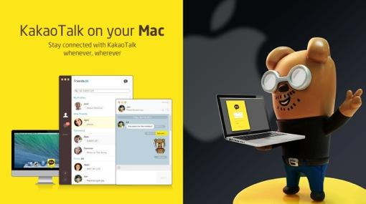
How KaKao did it?
iPhone 3G release in 2010, Korea
Similar UI with messaging
User play as co-creators
Desktop version
Notes:
Golden age, the more… the more…
lotus , People pay less effort
Invite users co-create
Desktop version
Result in the booming...

Slide 16
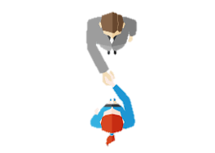

Being the Middleman is the way to be!
Side A
Sticker Maker
Game Provider
KTalk Login Account
adPOPcorn
Side B
Sticker User
Game Player
Consumers
Consumers
Notes:
KakaoTalk one-sided platform because it said no to adds and it managed to reach critical mass of 5 million users - 9 months. retailers soon joined the platform and it made a two-sided
It all started with Addictive emoticons which generated revenue over 100 billion won [$86 million],.
Gaming Platform - connect users with their friends automatically on a virtual scoreboard
Kakao Talk login account acts as a platform to use other services provided by Kakao Corp.
KakaoTalk has inked an agreement with digital marketing company IGAWorks to integrate adPOPcorn,which is an add Product to the messaging app.
Instead of bundling new features - separate apps- customer can decided one-sided or two-sided platforms.
So, now Kakao Talk is a platform as a potential channel for both marketing promotion and media.
.

Slide 17
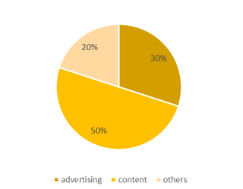
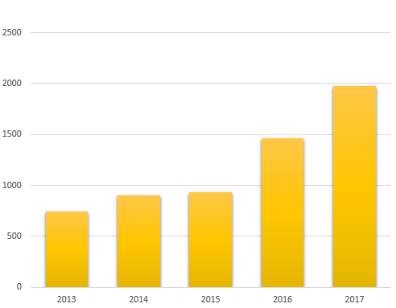
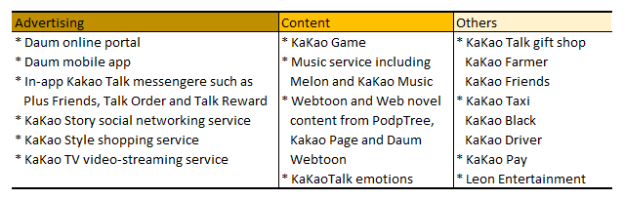
Money is all that matters!
Revenue in Billions in South Korean Won
KaKao Revenue in 2017
Notes:
Let’s look at the numbers. Kakao revenue for 2017 is around 1.97 trillion South Korean won. It is not only from Kakao Talk but from the other services as well. But, Kakao Talk is acting as a platform to generate the user base for the other services provided by Kakao .
So, it’s difficult to generate revenue ideas but still we tried.

Slide 18
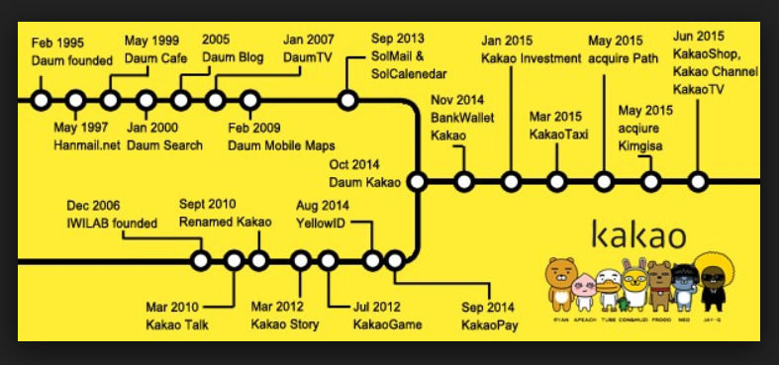
Kakao’s (monopoly)? in Korea
Notes:
Kakao’s journey is an interesting story, it has started in 2010 and built it’s empire by expanding into many businesses. You name it, Kakao has it. except for the Food Business.

Slide 19


Is there something Kakao doesn’t have?
Expanding
to
International Market
Kakao Talk
+
Food Delivery
+
Kakao Taxi
Notes:
Intergrate the 3 apps.

Slide 20
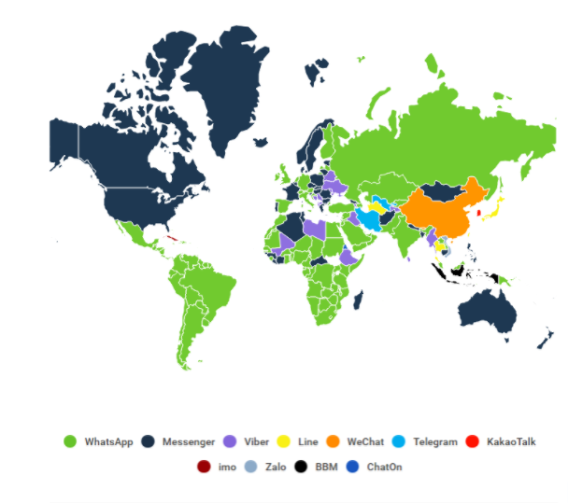
Hey, I’m the BEST in Korea!
Notes:
There are only 6million users outside Korea using Kakao.
If you look at the Global Map, it is only a small dot.
So, it has to expand it’s market Globally

Slide 21
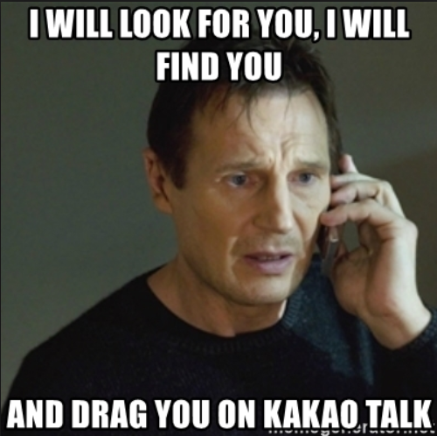
Let the whole world KaTalk!
Advertising - Airing as TV commercials
Influencer Marketing - Celebrities using it
Promoting in Sitcoms or TV series

Slide 22

How does Kakao delivery system work?

Slide 23
Is it a home run for the application dominating the market?
Sen. Graham - “You don’t think you have a monopoly?”
Mark - “No Senator, the average American uses 8 different apps…”
Notes:
The final question we are addressing is, if mobile messaging, a winner takes all market? The straight forward answer would be "No" and even Zuckerberg feels the same. In the recent senate hearing, when he was asked if Facebook is a Monopoly, zuckerberg denied it and said that an average american uses 8 differnt apps.

Slide 24
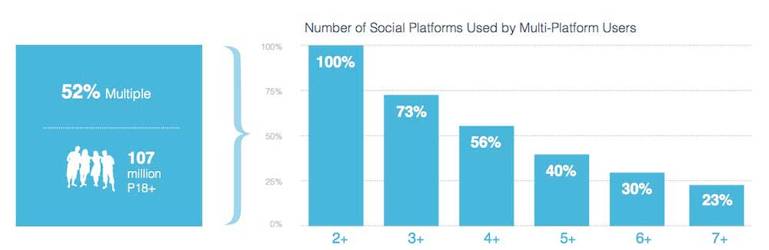
Notes:
We also have a survey that validates it. With 107 million 18+ year olds were asked, almost everyone said they use more than 2 apps and more than 50% of them actually use more than 4 apps. Even here, among us in this class we are not stuck with one mobile messaging app and we use different apps for different social circles and we have different personas in these apps. There is slack/skype that we use in office to talk to our colleagues and then there is whatsapp/wechat/messenger that we use to talk to our friends. And most of the time we actually use more than one app simultaneously. For example people from China, after coming to Singapore might have started using Whatsapp to talk to us and they might be using WeChat at the same time to talk to their friends back in China. Sometimes, some of us even use two or three apps to talk to different girlfriends or boyfriends.

Slide 25







Notes:
So when the market is like this, How do one become the market winner? One way is to buy over your competitors. Facebook did the exact same thing with Instagram and whatsapp. As soon they realized the potential these two social apps had, they bought them over. Does that make Facebook a market winner now? The same question was asked in the Senate hearing as well, Zuckerberg was questioned to name a direct competitor to Facebook and the business intenet behind buying Instagram. He was not able to give a solid answer. So, may be Facebook might have a market lead now but it cannot sustain forever.
When we look at history, Orkut and Myspace were actually the market winners and then Facebook completly overthrew them. This applies to mobile mesagging market as well. In the internet business, the entry barriers are very less and anyone can easily make a mobile messaging app or a social media app and release it into the market. There is almost zero cost involed in switching to different apps as well. Therefore, multiple mobile messenger apps will coexist in the market and there won't be one single winner. It's not a winner takes all it's winner takes some.

Slide 26
Questions?
Are we going to talk on messenger?
Are we going to KaTalk?
OR

